Slide 1
Stock Forecasting with Hybrid Deep Learning and Anomaly Detection.
J Muniyandi - 2021UCS1577
Ramanjot Singh - 2021UCS1598
Mudit Jain - 2021UCS1604

Slide 2
Problem Statement
To propose a solution that integrates LSTM and XGBoost in an ensemble framework,
incorporating attention mechanisms for enhanced temporal pattern recognition , anomaly
detection methods for data quality assurance and interpretable predictions of stock price
movements based on both macroeconomic and fundamental indicators.

Slide 3
Why Use Fundamental Data and Macroeconomic Indicators?
Fundamental Data:
● Includes metrics like balance sheets, earnings, and P/E ratios.
● Reflects a company’s financial health and operational performance.
● Helps assess intrinsic value and growth potential.
Macroeconomic Indicators:
● Includes GDP, inflation rate, interest rate, unemployment rate etc.
● Reflects the broader economic environment and market sentiment.
● Influences stock prices across industries.
Combined Approach:
● Captures both company-specific and external economic factors.
● Provides a holistic and accurate method for stock price prediction.

Slide 4
Literature Survey
S.No. | Paper No. | Model | Insights
1 | [3, 7, 12] | ARIMA | these models assume stationarity in data, making them less effective in volatile stock markets
2 | [5, 9, 14] | Random Forest and Decision Trees | they lack sequential memory, limiting their performance in time-series forecasting
3 | [2, 8, 11, 17, 20] | Extreme Gradient Boosting (XGBoost) | it naturally lacks the ability to understand time-based relationships in the data
4. | [6, 13, 18] | Hybrid Models (SVR + XGBoost, ARIMA + XGBoost) | ARIMA is often used to model linear trends, while XGBoost is applied for nonlinear feature extraction, improving overall accuracy
5 | [1, 4, 6, 10, 15, 18] | Long Short-Term Memory (LSTM) | they sometimes fail to respond to short-term fluctuations and external market factors

Slide 5
6 | [7, 11, 16] | Attention-Based Mechanisms | enhanced LSTM performance using attention mechanisms, which prioritize significant time steps in sequential data
7 | [12, 19] | Autoencoder-Based Anomaly Detection | technique that reconstructs normal data patterns and flags deviations
8 | [8 , 10 , 12 , 13] | Isolation Forest for anomaly detection | Detect and removed anomalies in high-dimensional data, ensuring cleaner and more reliable input for model training

Slide 6
Data Preprocessing
1. Stock Prices (Yahoo Finance): Daily stock data for Google, Amazon, Apple, Tesla, and Nvidia,
including open, high, low, close, and volume prices, collected from the earliest available records
to the most recent.
2. Financial Fundamentals (Alpha Vantage): Quarterly financial metrics like EPS,
ROE, balance sheets, and income statements, ensuring consistent quarterly
frequency.
3. Macroeconomic Indicators (FRED): Monthly/quarterly GDP, inflation, and
interest rate data aligned with company fundamentals for temporal consistency.

Slide 7
Data Merging & Temporal Alignment
Frequency mismatches (e.g., daily vs. quarterly) were resolved using:
Interpolation for continuous values.
Aggregation (e.g., computing quarterly or monthly averages) to match financial and macroeconomic reporting periods.
Macroeconomic variables (like GDP, Inflation Rate, and Interest Rate) were sourced from the Federal Reserve Economic Data (FRED) and aligned with the quarterly cadence of company earnings.
Company fundamentals such as Total Revenue, Net Income, Gross Profit, and Cash Flow from Financing were merged with daily stock data like Open, High, Low, Volume, and Adjusted Close.
Feature Scaling:
To improve model convergence and performance:
Min-Max Scaling was applied for time-series models like LSTM.
Standardization (Z-score normalization) was used for tree-based models like XGBoost and meta-learners in the stacked ensemble.

Slide 8
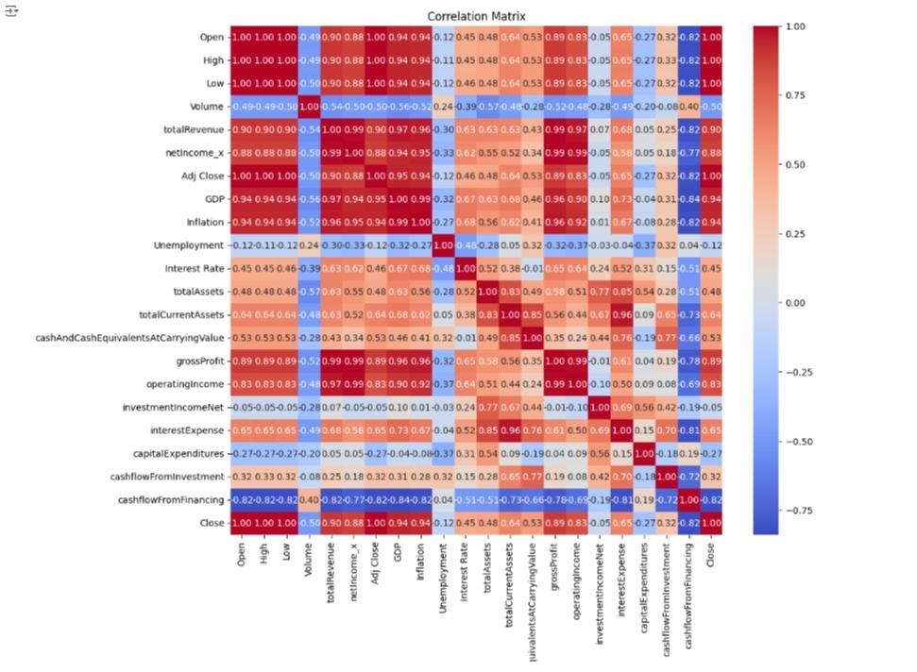
Correlation Heatmap Insights
Strongly Correlated with Closing Price (Close): Adj Close: 1.00 ,Open, High, Low: 0.95 – 0.99 ,Net Income (netIncome_x): 0.93 ,Gross Profit: 0.89 ,total Revenue: 0.85 ,GDP: 0.84 ,Cash Flow from Financing: 0.83
Moderately Correlated: Volume: 0.40 ,Interest Rate: ~0.52 ,Total Assets: ~0.58 ,Unemployment & Inflation: ~0.4 – 0.6
Weak or Low Correlation:Cash Flow from Investment: ~0.19 ,Capital Expenditures: ~0.13 ,Interest Expense: ~0.15 ,Investment Income (Net): ~0.09
Based on correlation strength and domain relevance, the following features were selected for model training:
Open, High, Low, Volume, Adjusted Close, Total Revenue, Net Income, Gross Profit, GDP, Cash Flow from Financing .These variables exhibit strong or moderate correlation with stock price movement and provide a balanced mix of technical, fundamental, and macroeconomic signals.

Slide 9
LSTM
The LSTM model was designed to capture temporal dependencies in stock price time series data.
Incorporated multiple layers and units, using appropriate activation functions to achieve a balance between complexity and performance.
High-level parameters such as:
● Learning Rate: Controlled the step size during optimization.
● Batch Size: Defined the number of samples used per gradient update.
Cross-validation techniques were employed to:
● Fine-tune these parameters.
● Improve model generalization and predictive accuracy.
This approach ensured the LSTM model effectively learned long-term dependencies and patterns in stock price data.

Slide 10
Stacked Model
Combined LSTM and XGBoost as base models:
● LSTM: Captured temporal dependencies in stock price data.
● XGBoost: Modeled feature-driven patterns effectively.
Implemented a multi-level stacking ensemble technique to improve prediction accuracy:
● Outputs from LSTM and XGBoost served as inputs for a meta-learner.
The meta-learner:
● Functioned as a straightforward regression model.
● Integrated strengths of both base models to enhance final predictions.
This approach boosted the overall efficacy and resilience of the predictive framework.

Slide 11
Anomaly Detection for Data Cleaning
We used different anomaly detection methods to improve data quality and reduce noise.
● Isolation Forest: Detected and removed unusual price movements that could distort predictions.
● Autoencoder-Based Anomaly Detection: Utilized Autoencoder networks to detect complex patterns of irregularities in time-series data.
Data cleaning significantly improved model generalization, leading to a more robust Predictive model.

Slide 12
Proposed Hybrid Model for Enhanced Prediction Accuracy
Anomaly Detection for Data Cleaning
Used Isolation Forest to remove extreme fluctuations in stock prices.
Applied Autoencoder-Based Anomaly Detection to detect irregularities in time-series data.
Improved data quality, reducing noise and enhancing model generalization.
Autoencoder for Feature Extraction
Reduced dimensionality to eliminate redundant features and improve efficiency.
Filtered out irrelevant noise, ensuring the model focuses on meaningful stock trends.
Attention-Based LSTM for Temporal Learning
Introduced an attention mechanism to prioritize significant time steps.
Enhanced trend detection for better stock price movement predictions.
XGBoost for Final Prediction
Combined Autoencoder and Attention-LSTM refined features for optimal forecasting.
Used a decision-tree-based approach to maximize predictive accuracy.

Slide 13
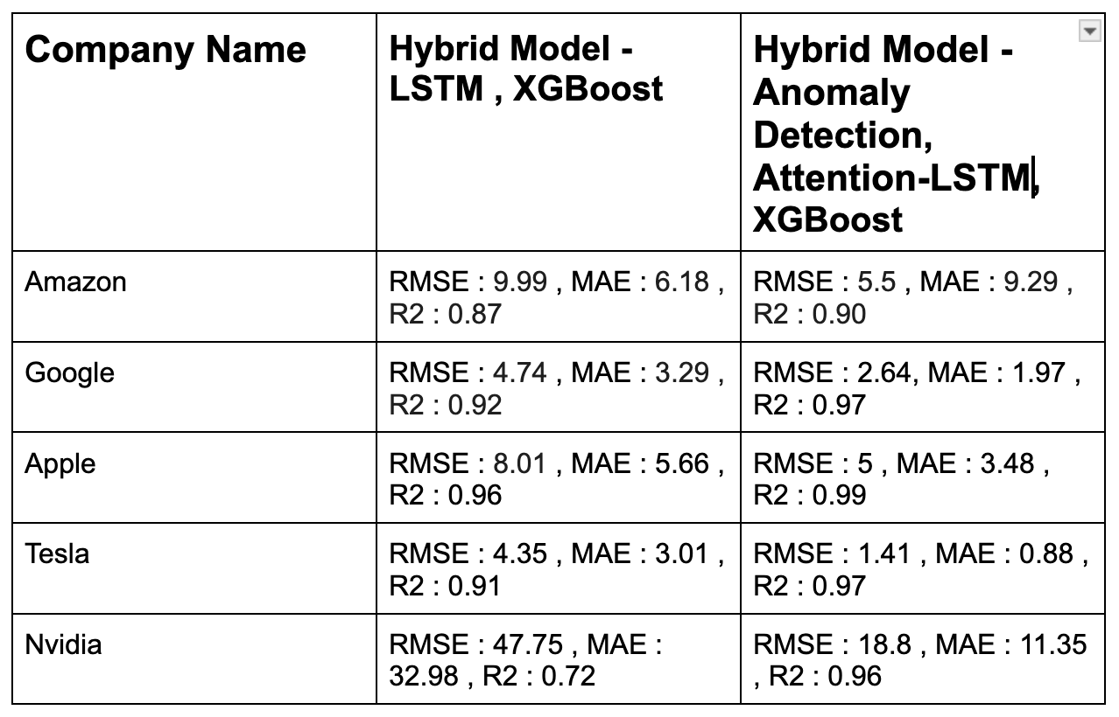
RESULTS

Slide 14
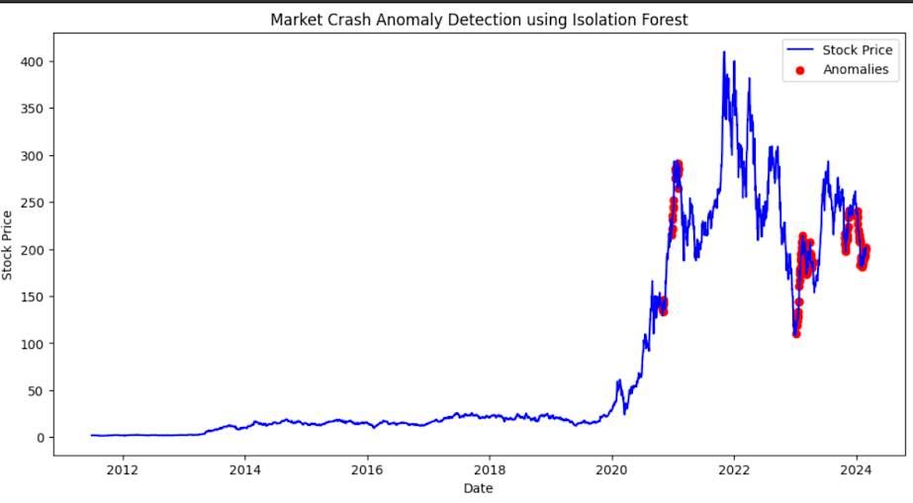
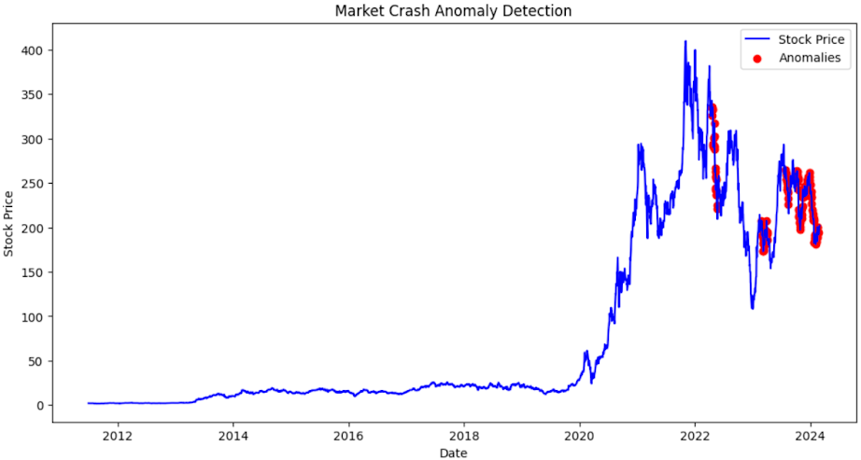
TESLA
Isolation Forest
Autoencoder

Slide 15
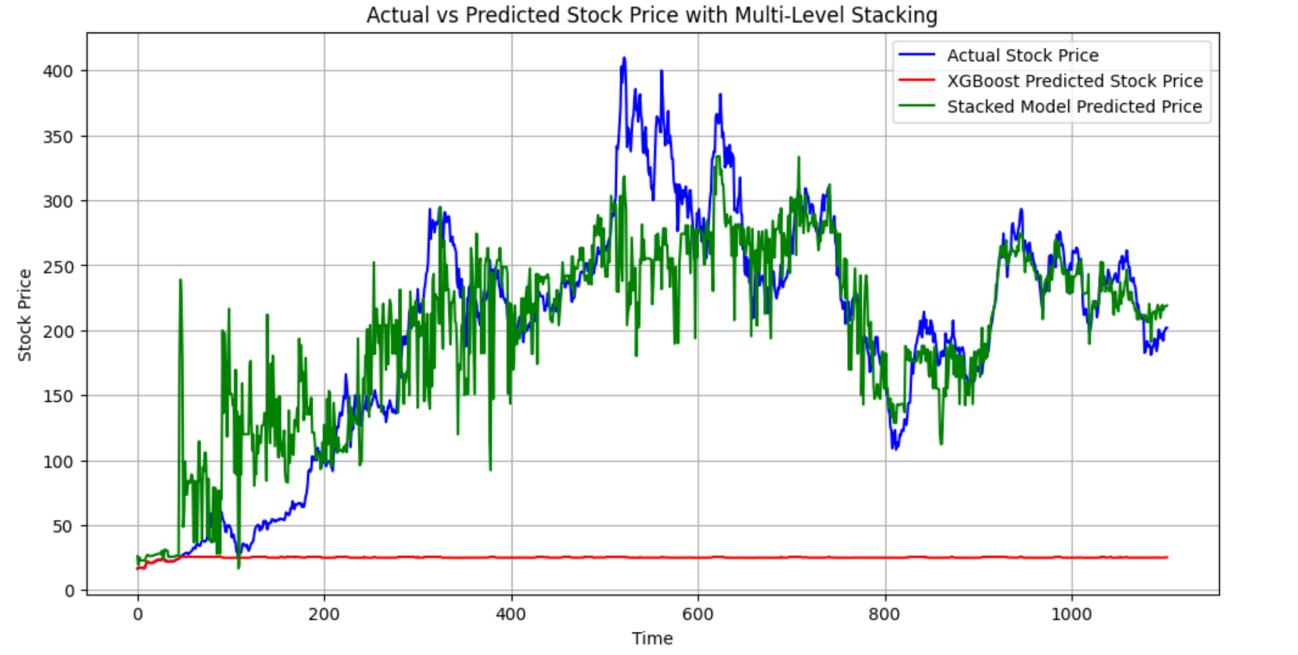
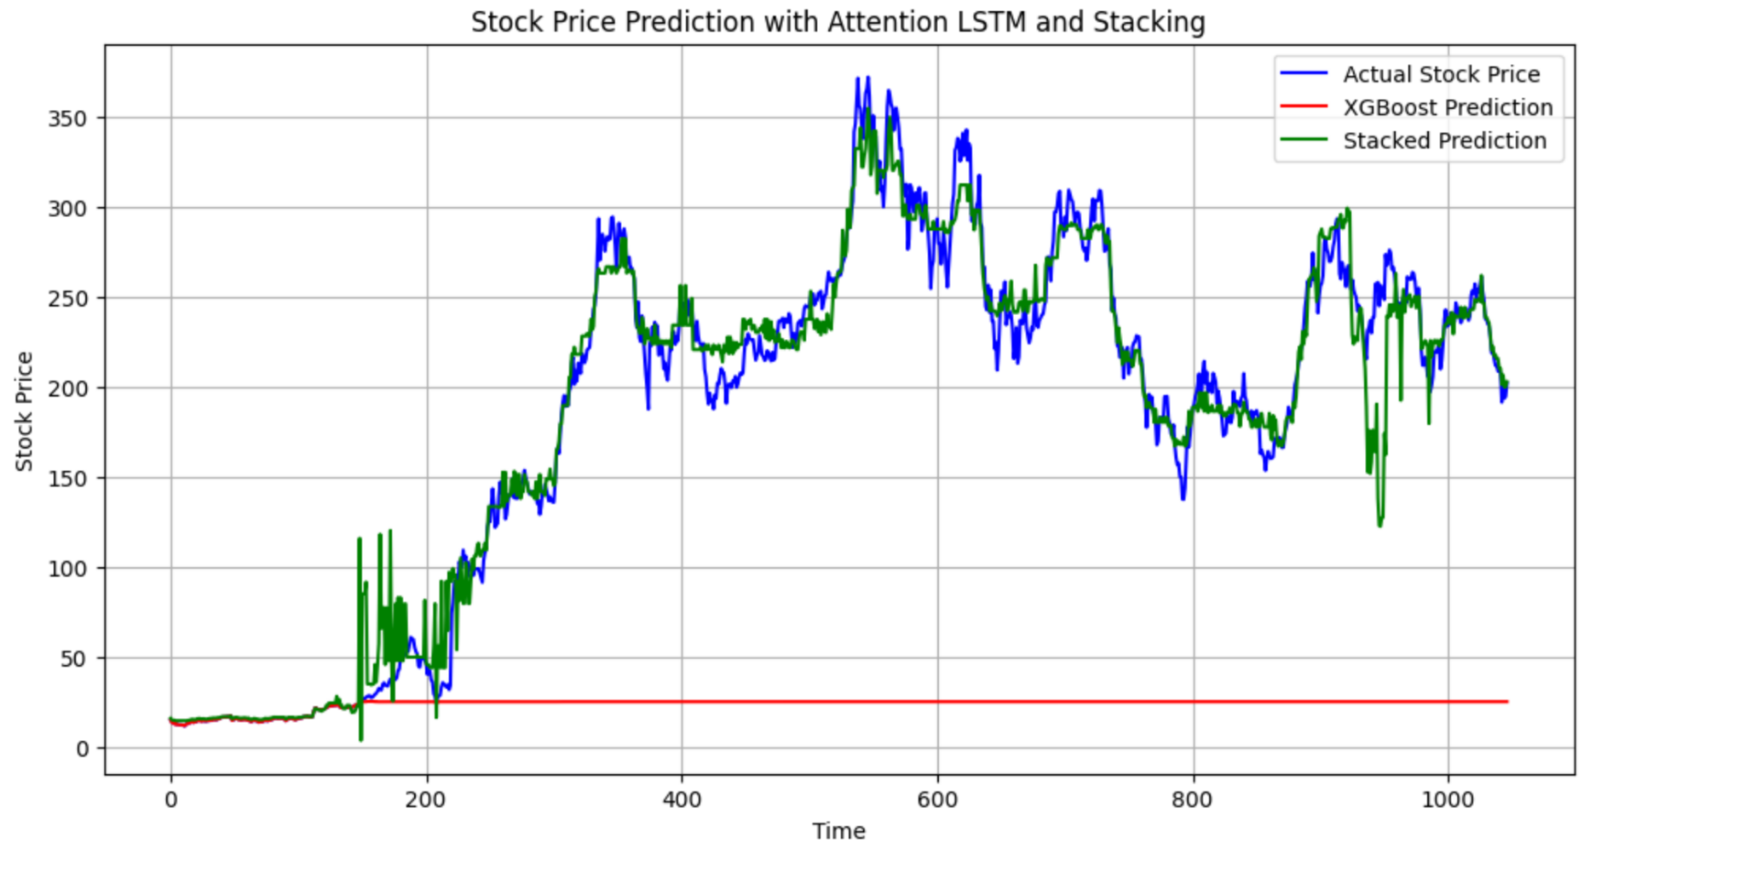
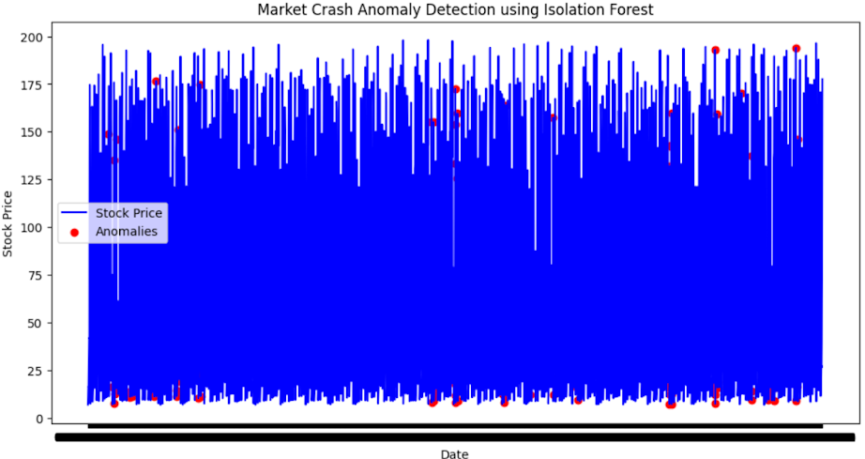
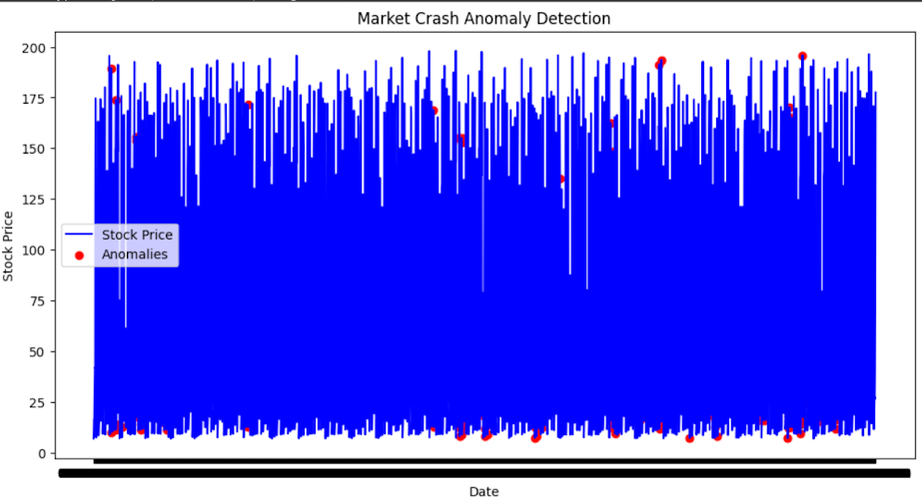
TESLA
Hybrid Model - LSTM, XGBoost
Hybrid Model - Anomaly Detection, Attention-LSTM, XGBoost

Slide 16
Conclusion
The aim of this research was to predict the stock prices for the largest tech companies utilizing company financials and traditional economy signals as Input.
The study examined a new hybrid model which integrated anomaly detection methodology to improve the robustness of the model. The experimental results were very strong in all situations. The hybrid model predicted the stock prices for Google with R2 scores of .97, Apple - .99, Tesla - .97, and Nvidia -.96 , Amazon - 0.90.
These results were in addition to historical LSTM models, the inputs also produced lower RMSE and MAE metrics, as well as providing an economic rationale and therefore the capability of recognizing complex market behaviour.

Slide 17
Future Work
Multimodal Data: Integrate more technical metrics (MACD, Bollinger Bands) , financial reports, economic signals, and social media insights for a fuller market view.
Real-Time Prediction: Enhance the model to make live predictions using streaming data.

Slide 18
Thank you

